Slide 1
L6 – Data Parallelism

Slide 2
Different Types of Parallelism
Instruction-Level Parallelism
VLIW, Superscalar, EPIC
Thread-Level Parallelism
SMT, Multicore
Task-Level Parallelism
Multicore Processors
Multiprocessor Systems: Shared and Distributed Memory
Data-Level Parallelism

Slide 3
Data Level Parallelism
Vector Processors
Single instruction on multiple data (elements of a vector – temporal)
Array Processors
Single instruction on multiple data (elements of a vector / array – spatial )
Modern Processors
MMX / SSE / AVX instructions
Graphic Processing Units
Multiple SIMD Cores in each Streaming Processors

Slide 4
Intel SIMD Extensions
New SIMD instructions, new registers
Introduced in phases/groups of functionality
MMX (1993 – 1999)
64 bit width operations
SSE – SSE4 (1999 –2006)
128 bit width operations
AVX, FMA, AVX2, AVX-512 (2008 – …)
256 – 512 bit width operations
© RG@SERC,IISc

Slide 5
SIMD Operations
SIMD execution
performs operation in parallel on an array of 2, 4, 8,16 or 32 values
Operation ⊗ can be a
data movement instruction
arithmetic instruction
logical instruction
comparison instruction
conversion instruction
shuffle instruction
X0
X1
X2
X2
Y0
Y1
Y2
Y3
⊗
⊗
⊗
⊗
Z0
Z1
Z2
Z3

Slide 6
Intel SIMD Registers (AVX-512)
XMM0 – XMM15
128-bit registers
SSE
YMM0 – YMM15
256-bit registers
AVX, AVX2
ZMM0 – ZMM31
512-bit registers
AVX-512
XMM0
YMM0
ZMM0
XMM1
YMM1
ZMM1
…
XMM31
YMM31
ZMM31
© RG@SERC,IISc

Slide 7
SSE/AVX Data Types
255
0
YMM0
float
float
float
float
float
float
float
float
double
double
double
double
int32
int32
int32
int32
int32
int32
int32
int32
16
16
16
16
16
16
16
16
16
16
16
16
16
16
16
16
8
8
8
8
8
8
8
8
8
8
8
8
8
8
8
8
8
8
8
8
8
8
8
8
8
8
8
8
8
8
8
8
Operation on 32 8-bit values in one instruction
Or 4 64-bit values, 8 32-bit values, or 16 16-bit values!
© RG@SERC,IISc

Slide 8
Exploiting Vector Instructions
Automatic vectorization by the compiler
no explicit vectorized programming is needed
arrange code so that compiler can detect vectorization
Explicit arithmetic expression on vector data types
declare variables of a vector type and express computations as normal arithmetic on vector variables
the compiler generates vector instructions
Use compiler intrinsic for vector operations
functions implement vector instructions in high-level language
requires detailed knowledge of the vector instructions

Slide 9
Automatic Vectorization
In gcc, flags “-O3 –mavx –mavx2” attempts automatic vectorization
Works pretty well for simple loops
But not for anything complex
E.g., naïve bubble sort code not parallelized at all
L1: vmovdqa xmm1, X[rax]
vmovdqa xmm2, Y[rax]
vpmulld xmm0, xmm1, xmm2
vmovap Z[rax], xmm0
add rax, 16
cmp rax, 256
jne .L1
float X[256], Y[256], Z[256];
{ int i;
for (i=0; i<256; i++)
Z[i] = X[i] * Y[i];
}
© RG@SERC,IISc

Slide 10
Explicit Arithmetic Operations with Vector Data Type
Declare variables of vector data types and express computations with normal arithmetic expressions
the arithmetic operations (+, –, *, etc.) are overloaded with the corresponding vector operations
Compiler generates vector instructions for the arithmetic operations
__m128 *x_ptr, *y_ptr, z_ptr ; /* Pointers to vectors */
x_ptr = (__m128 *) X; /* Set pointers to the data */ y_ptr = (__m128 *) Y;
z_ptr = (__m128 *) Z;
for (i=0; i<n/4; i++) {
z_ptr[i] = x_ptr[i] * y_ptr[i]; /* Do the computation */
}

Slide 11
Vector Intrinsic Functions
Declare vector variables of the appropriate type
Load data values into the variables
Do arithmetic operations on the vector variables by calling intrinsic functions
float float *X, float *Y, float *Z ;
{ __m128 x_vec, y_vec, z_vec, res_vec; /* Vector variables */
for (i=0; i<n; i+=4) {
/* Vector of 4 alpha values */
x_vec = _mm_load_ps(&X[i]);
y_vec = _mm_load_ps(&Y[i]);
res_vec = _mm_mul_ps (x_vec, y_vec) ; /* Compute */ _mm_store_ps (&Z[i], res_vec); /* Store the result */
}
}

Slide 12
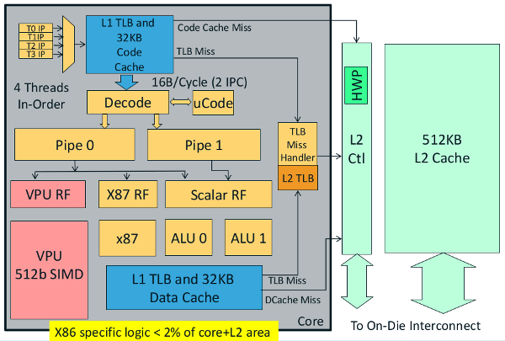
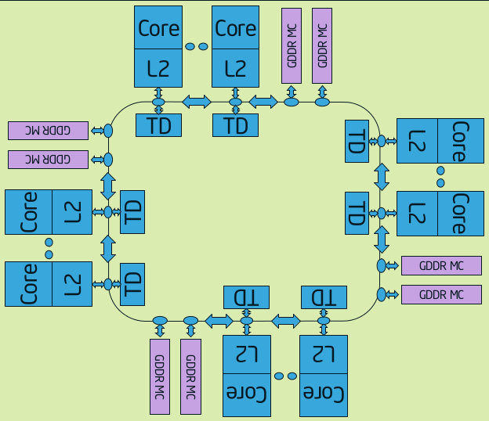
Intel Xeon Phi (Many Integrated Cores)
16-wide SIMD engine
Gather / Scatter Unit
Vector Mask

Slide 13
The Processor Core
Vector processing unit (VPU) associated with each core.
Sixteen-element wide SIMD engine
Gather / Scatter Unit
Vector Mask
13

Slide 14
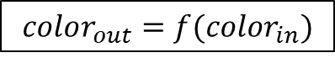
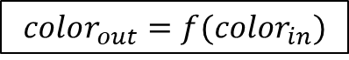
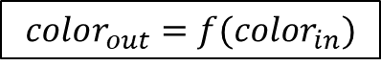
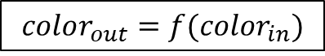
Generalization: Applicable to any data parallel workloads
Identical, Independent computation on multiple data inputs
0,7
7
1,7
6
2,7
5
3,7
4
Source: Arkaprava Basu, CSA, IISc

Slide 15
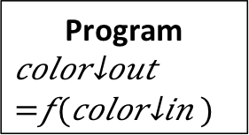
A SIMT Approach
Single Instruction Multiple Thread
Split identical, independent work over multiple lockstep threads
Multiple Threads + Scalar Ops → One PC, Multiple register files
0,7
1,7
Execute
Memory
Writeback
2,7
7
3,7
Execute
Memory
Writeback
Program
6
Fetch
Decode
5
Execute
Memory
Writeback
4
Execute
Memory
Writeback
Source: Arkaprava Basu, CSA, IISc

Slide 16
A SIMT Approach
Single Instruction Multiple Thread
Split identical, independent work over multiple lockstep threads
Multiple Threads + Scalar Ops → One PC, Multiple register files
Single Instruction Multiple Thread (SIMT) execution model.
Many SIMT “threads” (lockstep execution) grouped together (warp) for execution
Many such warps scheduled together (in a Streaming Multiprocessor (SM)) and context-switched (multithreading) among themselves to hide stalls.
Multiple SM’s execute groups of warps in parallel.
0,7
1,7
Execute
Memory
Writeback
2,7
7
3,7
Execute
Memory
Writeback
Program
6
Fetch
Decode
5
Execute
Memory
Writeback
4
Execute
Memory
Writeback
Source: Arkaprava Basu, CSA, IISc

Slide 17
Graphic Processing
Graphics Logical Pipeline
FIGURE A.2.3 Graphics logical pipeline. Programmable graphics shader stages are blue, and fixed-function blocks are white. Copyright © 2009 Elsevier, Inc. All rights reserved.

Slide 18
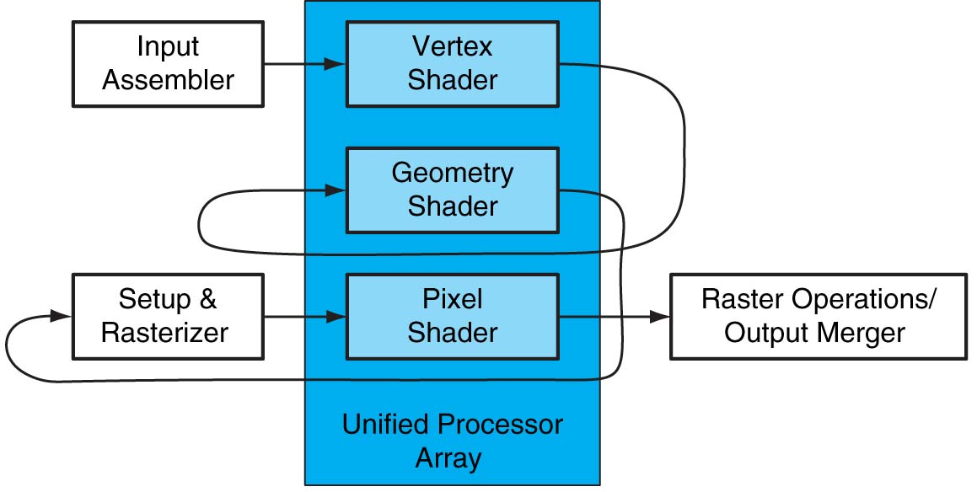
Unified GPU Architecture
FIGURE A.2.4 Logical pipeline mapped to physical processors. The programmable shader stages execute on the array of unified processors, and the logical graphics pipeline dataflow recirculates through the processors. Copyright © 2009 Elsevier, Inc. All rights reserved.

Slide 19
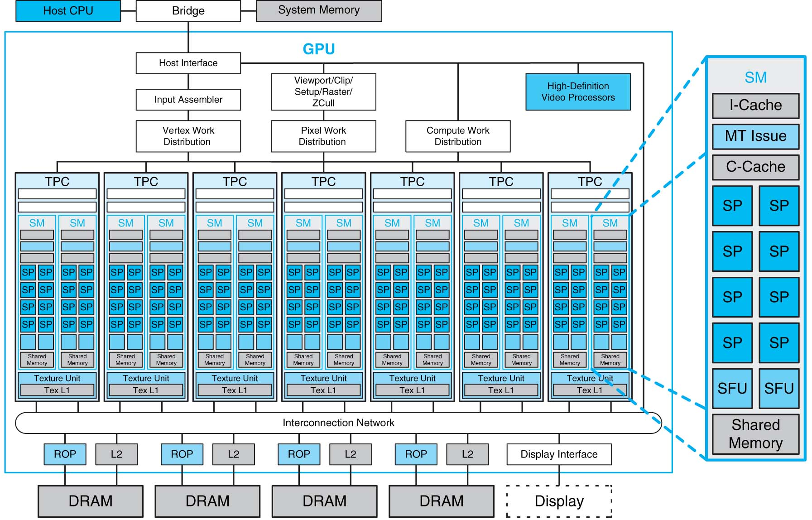
Graphic Processor 8800

Slide 20
Graphics Processing Unit (GPU)
Processor optimized for 2D/3D graphics, video, visual computing, and display.
Highly parallel, highly multithreaded multiprocessor optimized for visual computing.
Provides real-time visual interaction with computed objects via graphics images, and video.
Serves as both a programmable graphics processor and a scalable parallel computing platform.
Notes:
Over the past few years . . .
. . . Allow the programmer to create 1000’s of threads each of which executes the same
Previous work has successfully ported over several applications to the GPU and in some cases

Slide 21
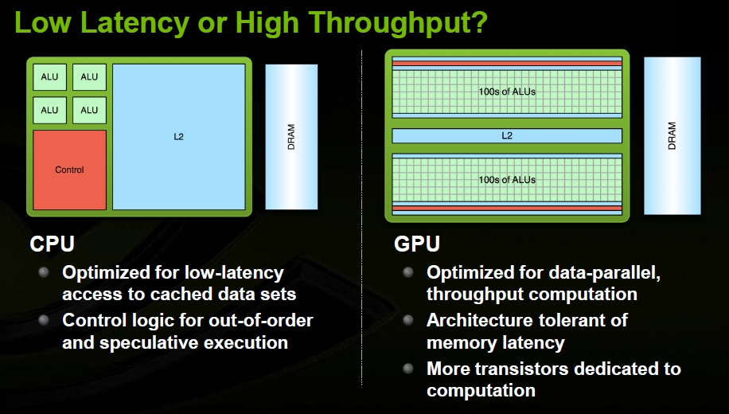
Comparing CPU and GPU

Slide 22
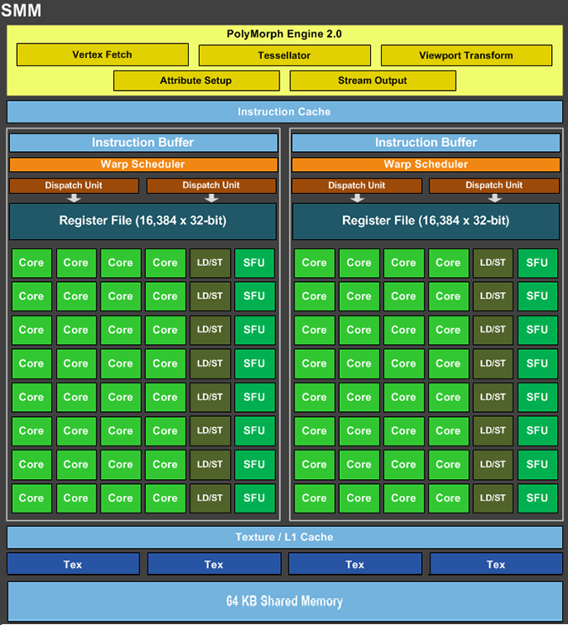
Comparing CPU and GPU
8-24 CPU cores @ 3 GHz
380 – 1200 GFLOPS
2880 CUDA cores @ 1.67 GHz
1500 – 7500 GFLOPS
C0
C1
C7
SLC
IMC
QPI
PCI-e
Memory
Memory
CPU
GPU
© RG@SERC,IISc

Slide 23
Rise of GPGPU Computing
GPUs have become a popular platform for general purpose applications
Order of magnitude speedup over single-threaded CPU
New Programming Models
CUDA
OpenCL
OpenACC
OpenMP 4.x
Notes:
Over the past few years . . .
. . . Allow the programmer to create 1000’s of threads each of which executes the same
Previous work has successfully ported over several applications to the GPU and in some cases

Slide 24

Next Few slides from

Slide 25
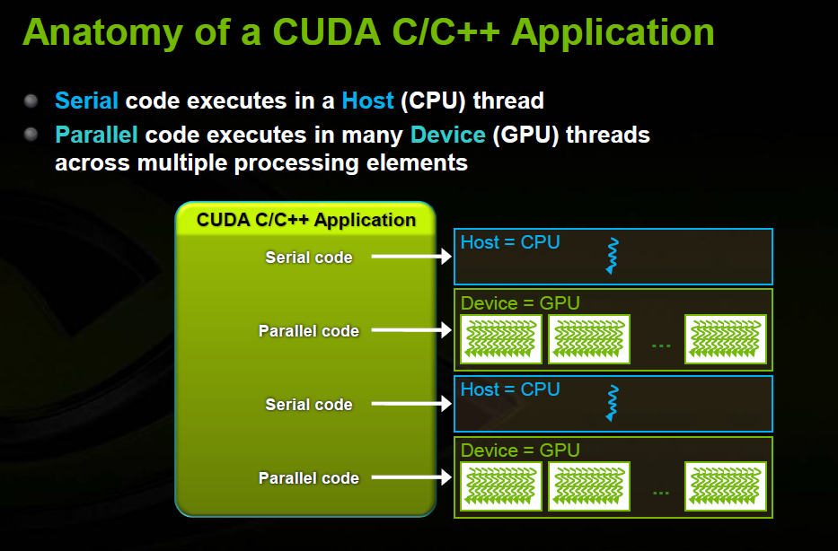
CUDA Programming

Slide 26
CUDA Programming

Slide 27
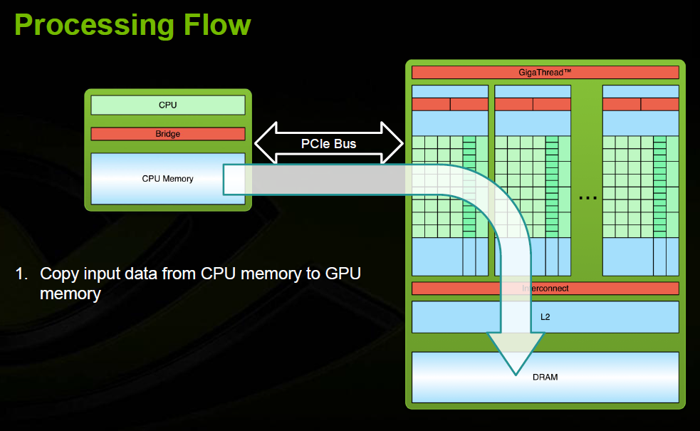
Processing Flow

Slide 28
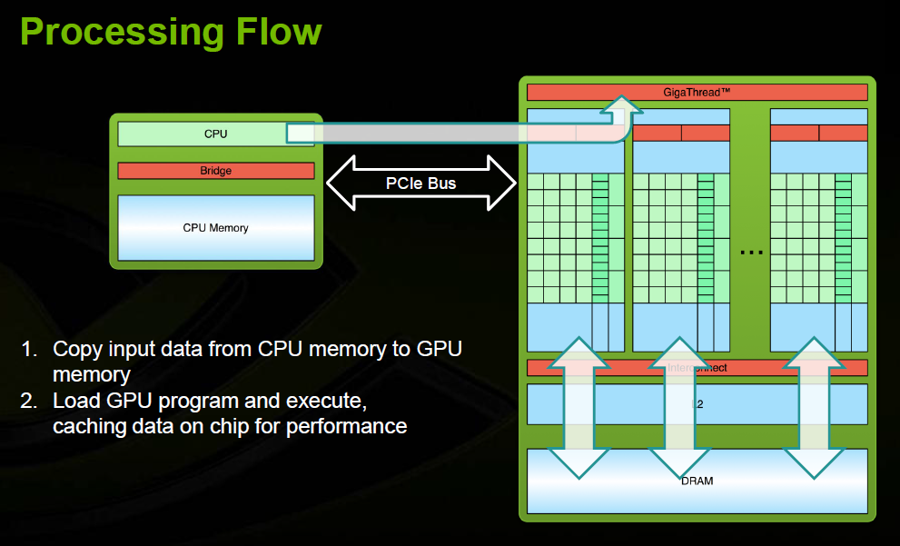
Processing Flow

Slide 29
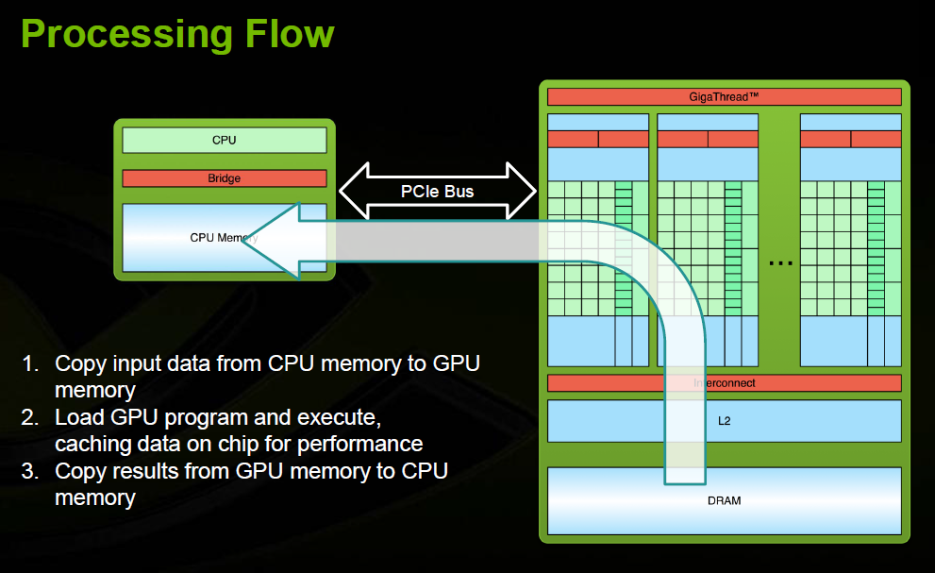
Processing Flow

Slide 30
Execution of CUDA on GPUs
A CUDA kernel consists of an array of light-weight threads
All threads run the same code, but on different data
Each thread has an ID that it uses to compute memory addresses and make control decisions
threadID
0
1
2
3
4
5
6
7
…
float x = input[threadID];
float y = func(x);
output[threadID] = y;
…

Slide 31
Threads, Warps, Thread Blocks
Group threads into multiple blocks
Threads within a block cooperate via shared memory and barrier synchronization
Thread block scheduled on a single SM
Consecutive k(=32) threads (within a block) form a warp
Instrn. from a ready Warp is scheduled each cycle
Thread Block 0
Thread Block 1
Thread Block N - 1
threadID
0
1
2
3
4
5
6
7
0
1
2
3
4
5
6
7
0
1
2
3
4
5
6
7
…
float x =input[threadID];
float y = func(x);
output[threadID] = y;
…
…
float x =input[threadID];
float y = func(x);
output[threadID] = y;
…
…
float x =input[threadID];
float y = func(x);
output[threadID] = y;
…
…

Slide 32
Thread Batching: Grids and Blocks
Host
Device
Program consists of many kernels
A kernel is a grid of 1-D or 2-D thread blocks
Each thread block is a 1-D, 2-D or 3-D array of threads
All threads do the same work; programmer specifies what a thread does
Threads in a threadblock can cooperate with each other
Synchronizing their execution
Sharing data through a low latency shared memory
Grid 1
Kernel 1
Block
(0, 0)
Block
(1, 0)
Block
(2, 0)
Block
(0, 1)
Block
(1, 1)
Block
(2, 1)
Grid 2
Kernel 2
Block (1, 1)
Thread
(0, 0)
Thread
(1, 0)
Thread
(2, 0)
Thread
(3, 0)
Thread
(4, 0)
Thread
(0, 1)
Thread
(1, 1)
Thread
(2, 1)
Thread
(3, 1)
Thread
(4, 1)
Thread
(0, 2)
Thread
(1, 2)
Thread
(2, 2)
Thread
(3, 2)
Thread
(4, 2)
Source : “NVIDIA CUDA Programming Guide”

Slide 33
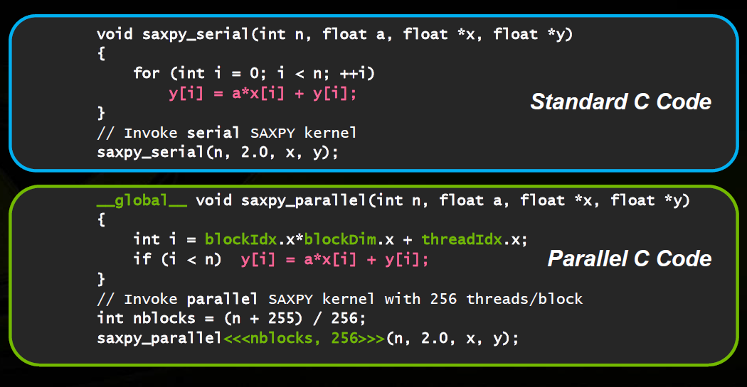
CUDA Programming
0
1
63
0
255

Slide 34
CUDA Programming
cudaMalloc((void **) &d_x, size);
cudaMalloc((void **) &d_y, size);
cudaMemcpy(d_x, h_x, size, cudaMemcpyHostToDevice);
cudaMemcpy(d_y, h_y, size, cudaMemcpyHostToDevice);
saxpy_parallel <<<nblocks, 256>>>(n,2.0, d_x, d_y)
cudaMemcpy(h_y, d_y, size, cudaMemcpyDeviceToHost);
cudaFree(d_x); cudaFree(d_y);

Slide 35
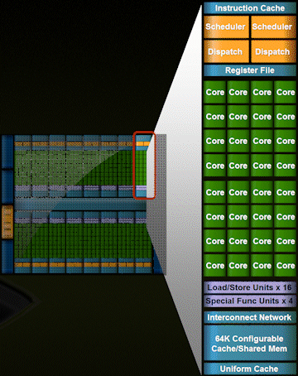
Accelerator – Fermi S2050

Slide 36
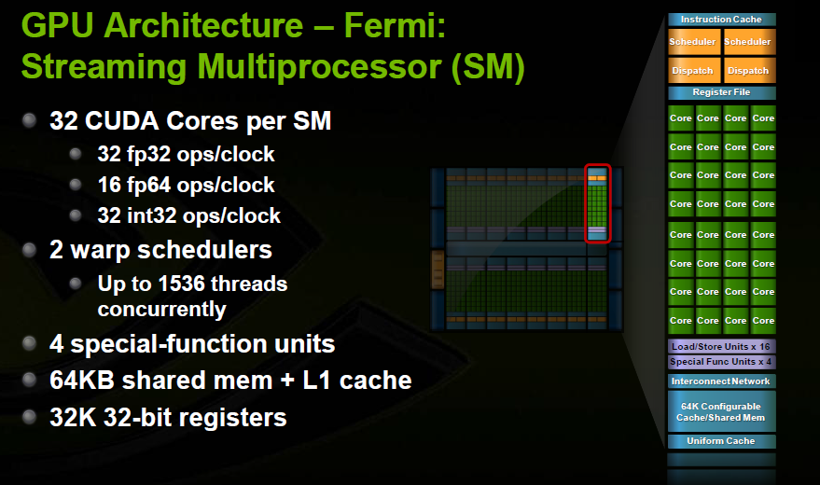
Streaming Multiprocessor

Slide 37
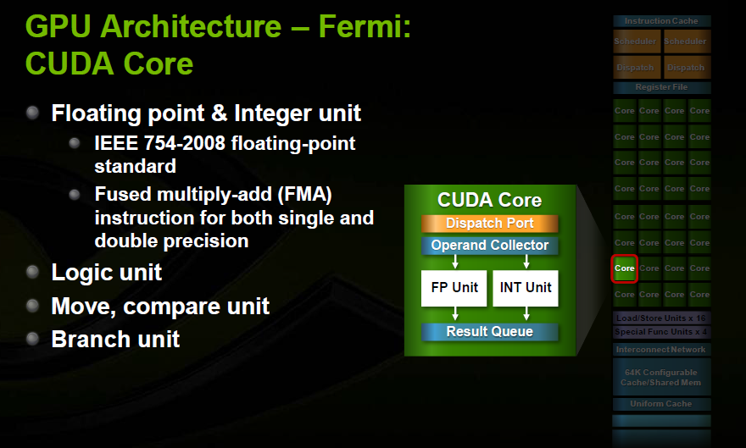
Inside a CUDA Core

Slide 38
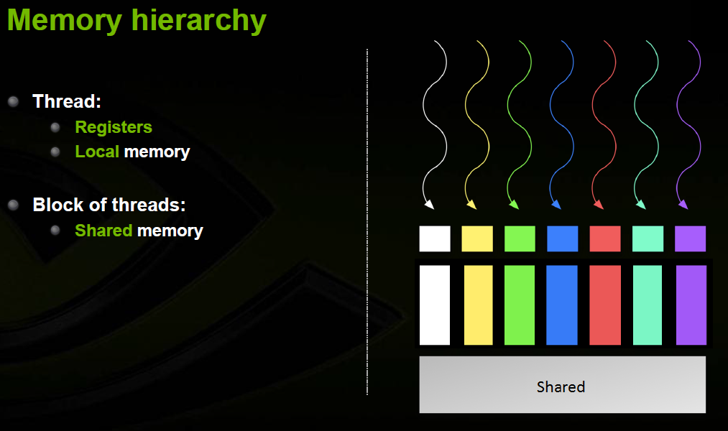
Memory Hierarchy in CUDA

Slide 39
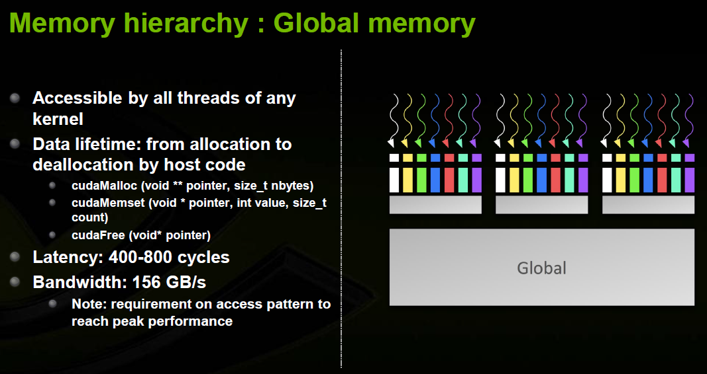
Global Memory

Slide 40
Global Memory Accesses
Each thread issues memory accesses to data types of varying sizes, perhaps as small as 1 byte entities
Given an address to load or store, memory returns/updates “segments” of either 32 bytes, 64 bytes or 128 bytes
Maximizing bandwidth:
Operate on an entire 128 byte segment for each memory transfer

Slide 41
Understanding Global Memory Accesses
Memory protocol for compute capability 1.2 and 1.3* (CUDA Manual 5.1.2.1 and Appendix A.1)
Start with memory request by smallest numbered thread. Find the memory segment that contains the address (32, 64 or 128 byte segment, depending on data type)
Find other active threads requesting addresses within that segment and coalesce
Reduce transaction size if possible
Access memory and mark threads as “inactive”
Repeat until all threads in half-warp are serviced
*Includes Tesla and GTX platforms as well as new Linux machines!

Slide 42
GPU cache hierarchy
GPU
SM Cluster
SM Cluster
SM Cluster
Coalescer
SM
SM
SM
SM
SM
SM
L1 $
L1 $
L1 $
L1 $
L1 $
L1 $
Interconnection Network
L2 $
Partition
L2 $
Partition
L2 $
Partition
Shared L2
GDDR5/HBM
GDDR5/HBM
Off-chip DRAM
GDDR5/HBM
Source: Arkaprava Basu, CSA, IISc

Slide 43
Cache Comparison of GPU & CPU
Primary purpose of GPU cache is to act as bandwidth filter
 | CPU | GPU
L1 data cache capacity | 32KB | 16 KB
Active threads sharing L1 D Cache | 2 (2-way SMT) | 2560
L1 dcache capacity / thread | 16KB | 6.4 bytes
Last level cache (LLC) capacity | 8MB | 1MB
Active threads sharing LLC | 8 | 81,920
LLC capacity / thread (4 cores) | 1MB | 9.6 bytes
Example comparison of CPU and GPU cache hierarchy
Source: Arkaprava Basu, CSA, IISc

Slide 44
GPU’s on-board memory
Goal: High bandwidth → need to service memory needs of thousands of active threads
Latency is far less of a concern
High frequency and many channels
Low frequency but wide bus
Typical b/w: ~500-600 GB/sec (compare that too top end CPU server 150GB/sec)
But capacity is limited. Typical GPU memory capacity 12-16 GB with max at 32GB.
Source: Arkaprava Basu, CSA, IISc

Slide 45
GPU TLB hierarchy
GPU
SM Cluster
SM Cluster
SM Cluster
Coalescer
SM
SM
SM
SM
SM
SM
L1 TLB
L1 TLB
L1 TLB
L1 TLB
L1 TLB
L1 TLB
L1 $
L1 $
L1 $
L1 $
L1 $
L1 $
Interconnection Network
L2 TLB
L2 $
Partition
L2 $
Partition
L2 $
Partition
Shared L2
GDDR5/HBM
GDDR5/HBM
Off-chip DRAM
GDDR5/HBM

Slide 46
Resident Thread Blocks
No. of threadblocks allocated to SM is limited by
Max. Threadblocks
Max. no. of threads
Registers (Regs. per thread * Thrds per Block * # Blks)
16K – 64 K registers per SM
Shared Memory (Shared Memory per Block * # Blks)
16K – 64KB shared memory/L1

Slide 47
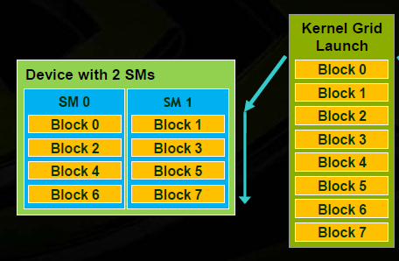
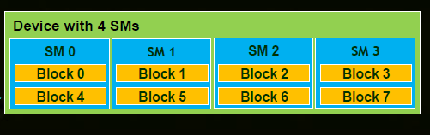
Threadblock Scheduling
Each TB allocated to an SM; Multiple TBs in a SM
Thread Blocks can execute in any order
Threads in a threadblock may need to cooperate
Load/Store from memory together
Share results (through shared memory)
Synchronize with each other

Slide 48
Thread & Warp Scheduling
Each Block is executed as 32-thread Warps
An implementation decision, not part of the CUDA programming model
Warps are scheduling units in SM
Warps of resident threadblocks are context switched to hide (long) latency
…
Block 1 Warps
…
Block 2 Warps
…
Block 1 Warps
…
…
…
t0 t1 t2 … t31
t0 t1 t2 … t31
t0 t1 t2 … t31
Streaming Multiprocessor
Instruction L1
Instruction Fetch/Dispatch
Shared Memory
SP
SP
SP
SP
SFU
SFU
SP
SP
SP
SP
48
L2: Hardware Overview

Slide 49
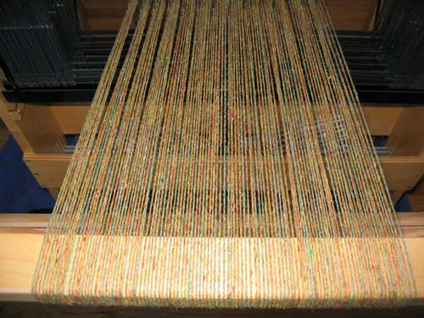
Warp Scheduling
Each SM launches Warps of Threads
Shared instruction fetch per 32 threads (warps)
SM hardware implements zero-overhead Warp scheduling
Warps whose next instruction has its operands ready for consumption are eligible for execution
Eligible Warps are selected for execution on a prioritized scheduling policy
All threads in a Warp execute the same instruction when selected
SM multithreaded
Warp scheduler
time
warp 8 instruction 11
warp 1 instruction 42
warp 3 instruction 95
. . .
warp 8 instruction 12
warp 3 instruction 96
Source : “Kirk-Hwu Lecture Notes”

Slide 50
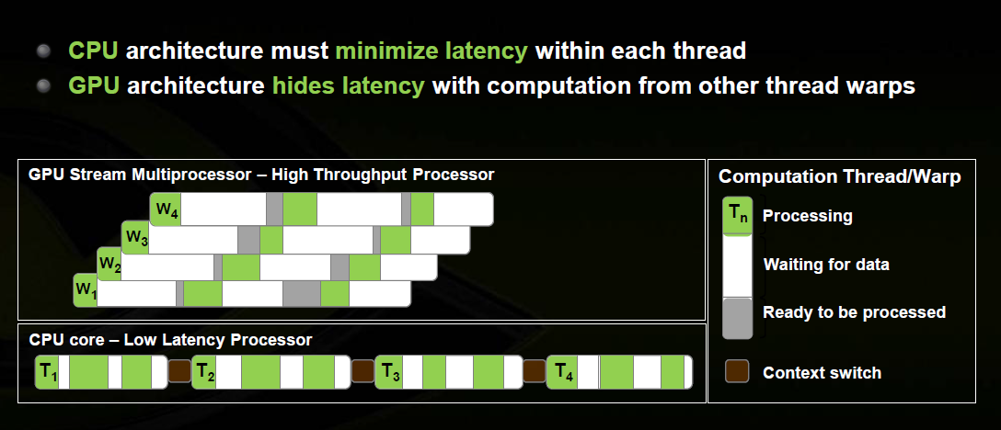
Context Switching to hide Latency

Slide 51
How is context switching so efficient?
Block 0
Thread 0
Register File
Block 0
Thread 1
Block 0
Thread 256
Block 8
Thread 1
Block 8
Thread 256
Block 8
Thread 0
Large register file (16K – 64 K registers per SM)
Each thread assigned a “window” of physical registers
Works if entire thread block’s registers do not exceed capacity (otherwise, compiler fails)
May be able to schedule from multiple blocks simultaneously
Similarly, shared memory requirements must not exceed capacity for all blocks simultaneously scheduled

Slide 52
Warp Scheduling
Many different warp schedulers
Loose Round Robin (LRR)
Two level
GTO
Criticality-aware, cache-aware, progress-aware, …

Slide 53
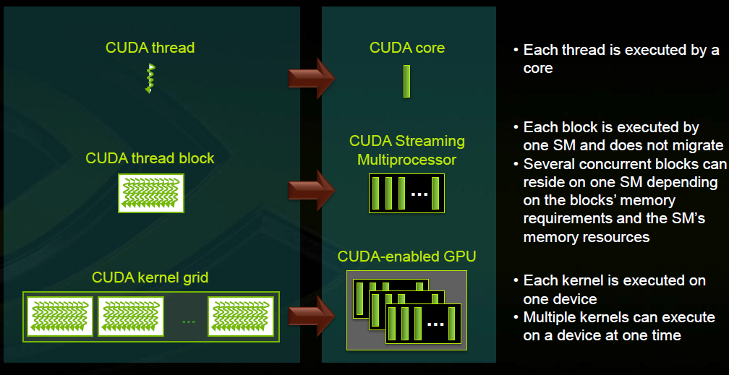
Kernel Execution

Slide 54
Execution Model Comparison
MIMD/SPMD
SIMD/Vector
SIMT
Example Architecture | Multicore CPUs | x86 SSE/AVX | GPUs
Pros | More general: supports TLP | Can mix sequential & parallel code | Easier to program Gather/Scatter operations
Cons | Inefficient for data parallelism | Gather/Scatter can be awkward | Divergence kills performance
Source: Arkaprava Basu, CSA, IISc
Notes:
Will explain pros/cons in depth later…this is a preview. End slide with: “Calling GPUs SIMT is a simplification. There is more to the story…”

Slide 55
Branch Divergence Problem
GPU uses SIMD pipeline to save area on control logic.
Group scalar threads into warps
Branch divergence occurs when threads inside warps branches to different execution paths.
Branch
Branch
Path A
Path A
Path B
Path B
Performance loss with SIMD width < 32

Slide 56
PDOM-Based Reconvergence
Stack
Reconv. PC
Next PC
Active Mask
TOS
TOS
TOS
TOS
-
-
-
-
-
-
-
G
A
E
E
B
E
E
1111
1111
1111
1111
1111
1111
A/1111
1111
A
E
E
D
D
0110
TOS
E
D
0110
0110
TOS
TOS
E
E
C
E
1001
1001
B/1111
B
Thread Warp
Common PC
C/1001
D/0110
C
D
Thread
1
Thread
2
Thread
3
Thread
4
E
E/1111
G
G/1111
A
B
C
D
E
G
A
Time

Slide 57
Recent research in GPU
Integrated Heterogeneous Architectures / Heterogeneous System Architecture (HSA)
CPU cores and GPU cores together in the same die
Sharing of resources (including last level cache, memory, …)
Virtual memory support
TLB /Address Translation for GPUs
Supporting large pages in GPU
Concurrent applicaions in GPU

Slide 58
Recent research in GPU
Unified Address Space
Unified Virtual Addressing (allocated at host, 32B transfers)
Unified Memory (allocated at device, 4KB transfers)
Unified Virtual Memory (UVM)

